Slide 3
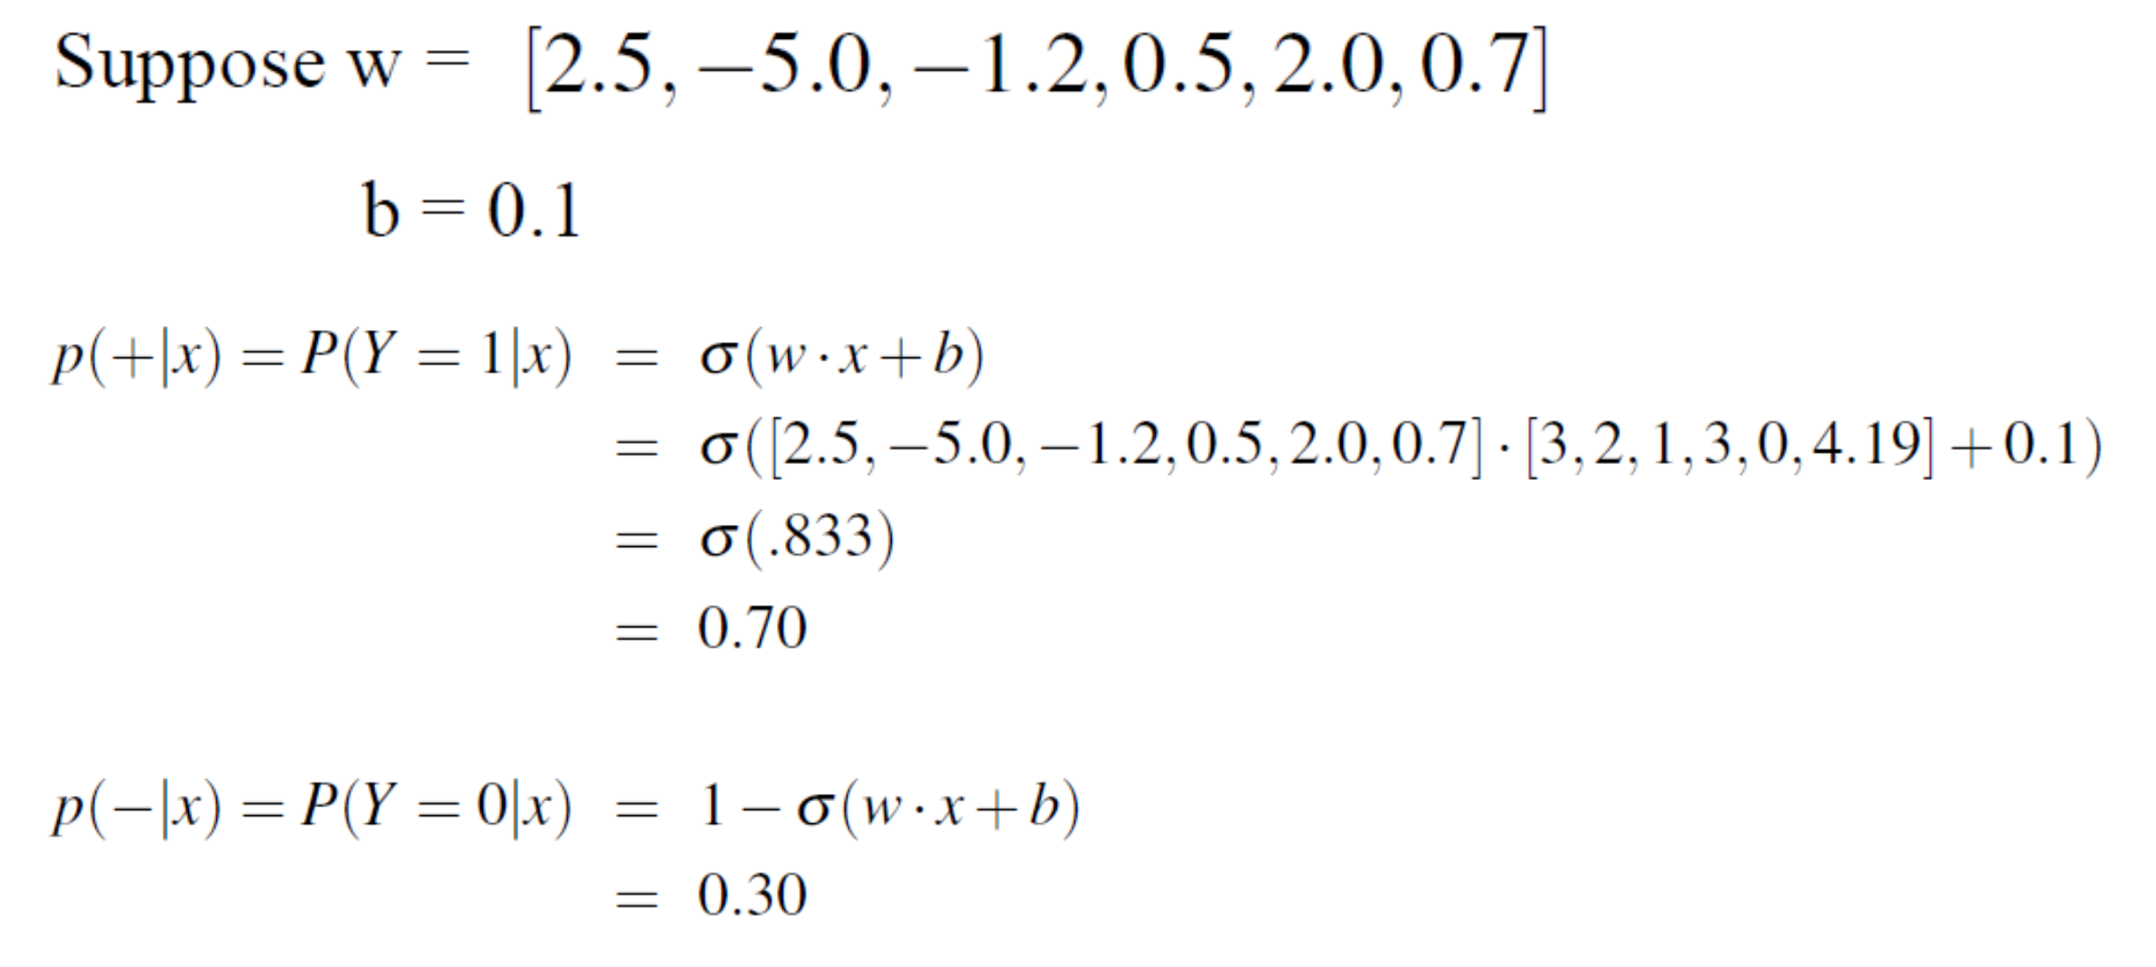
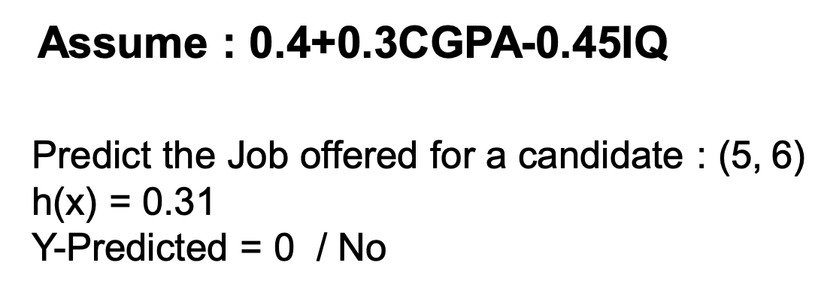

Slide 4
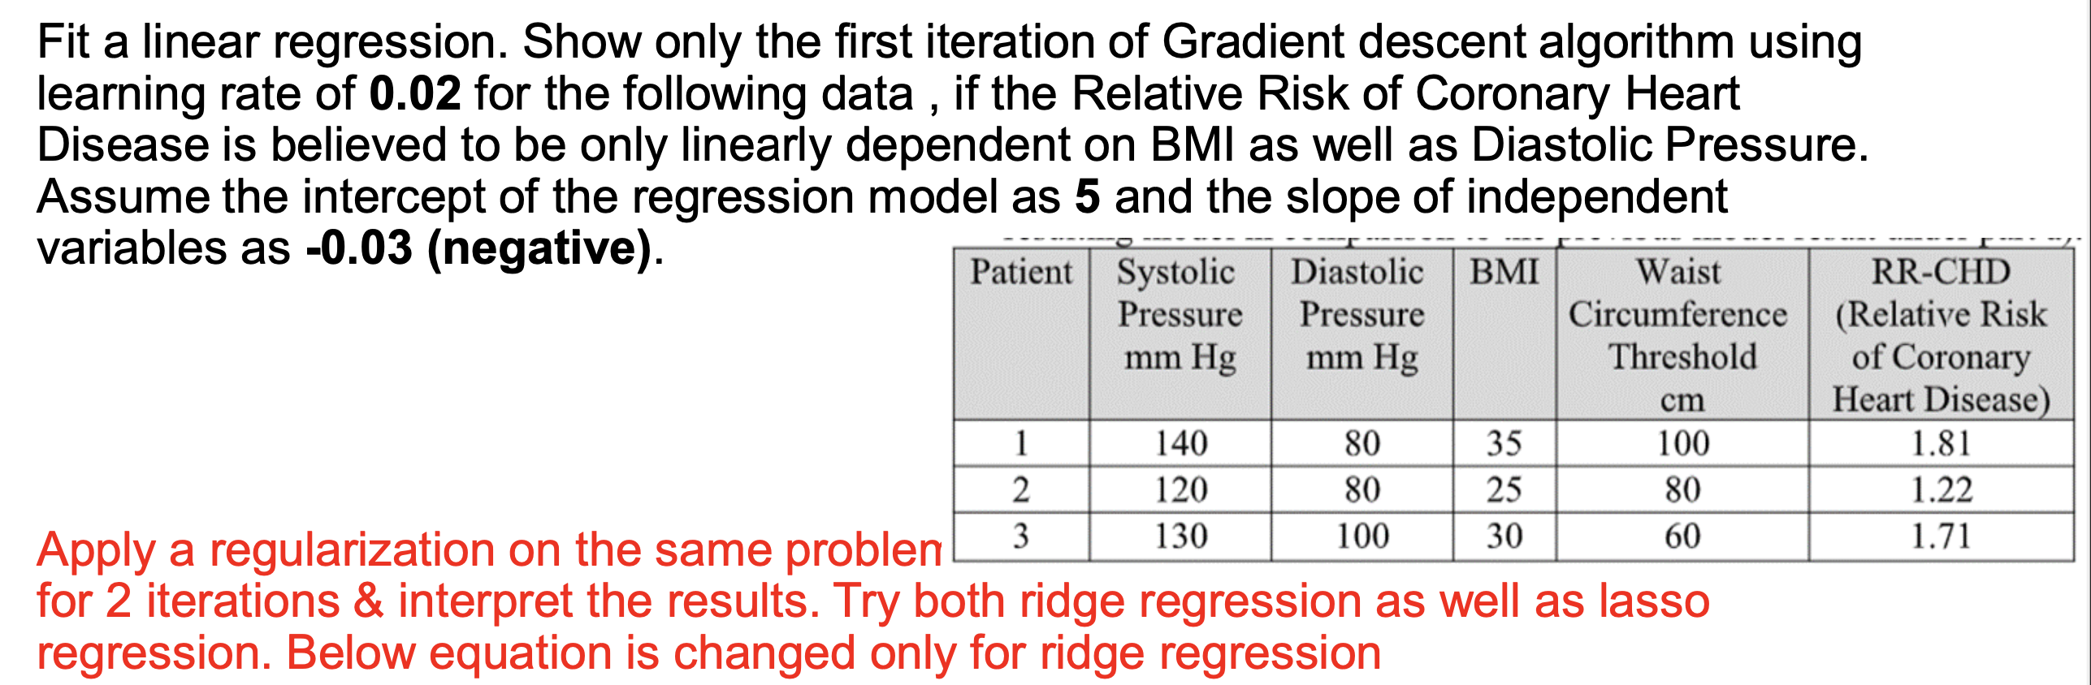
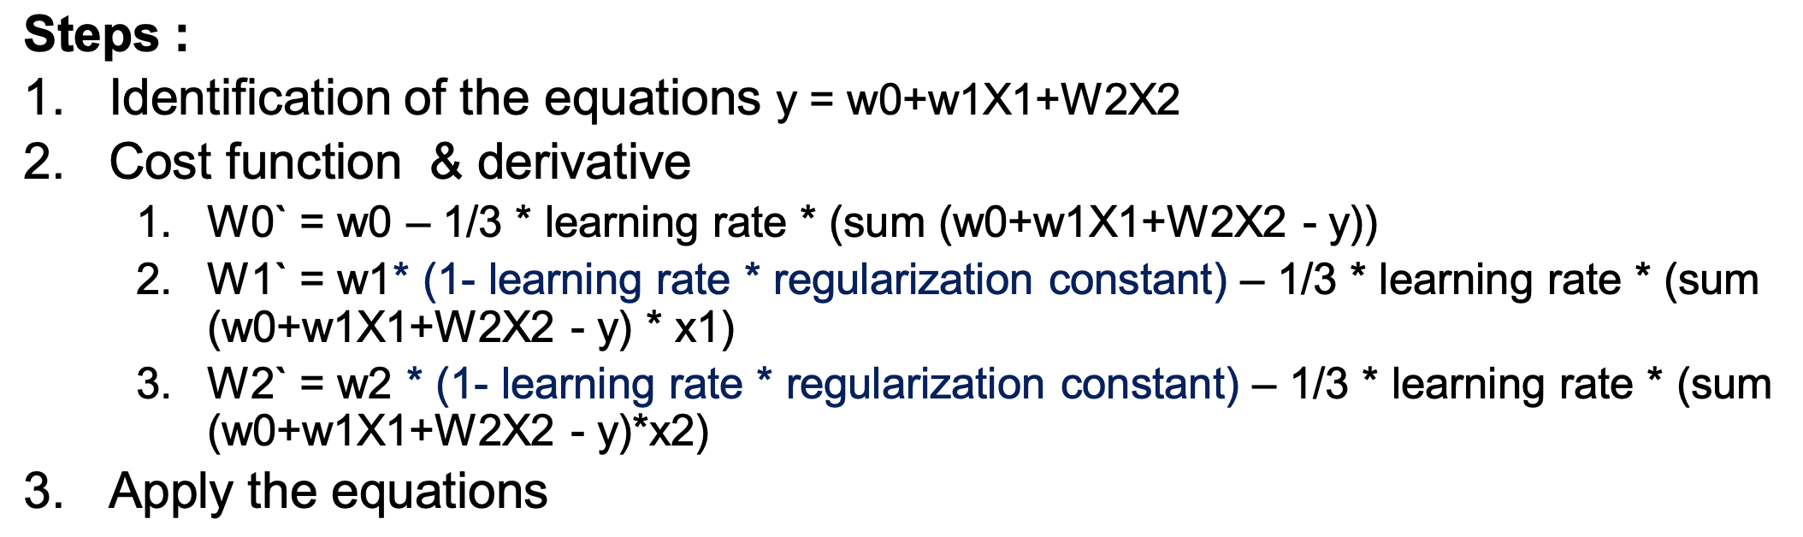

Slide 6
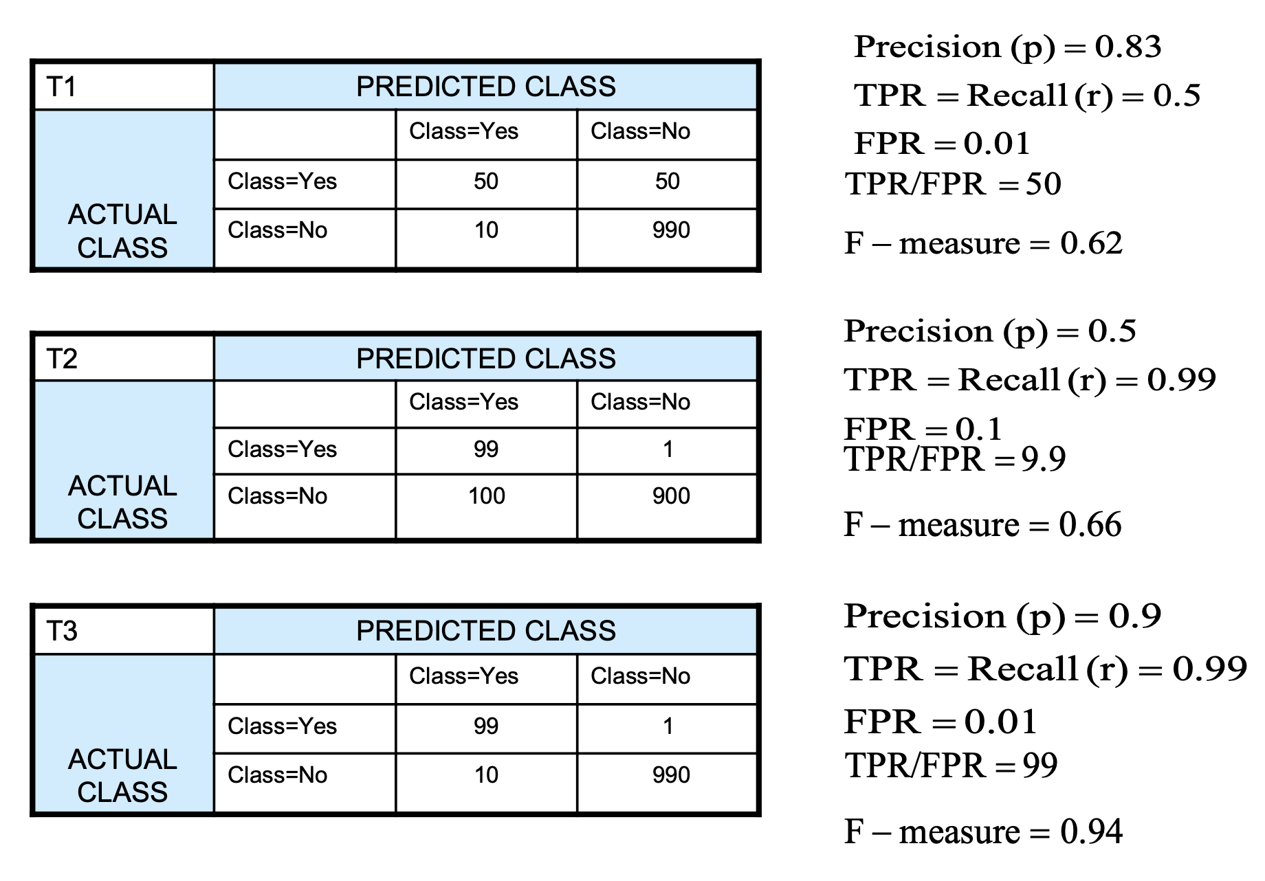
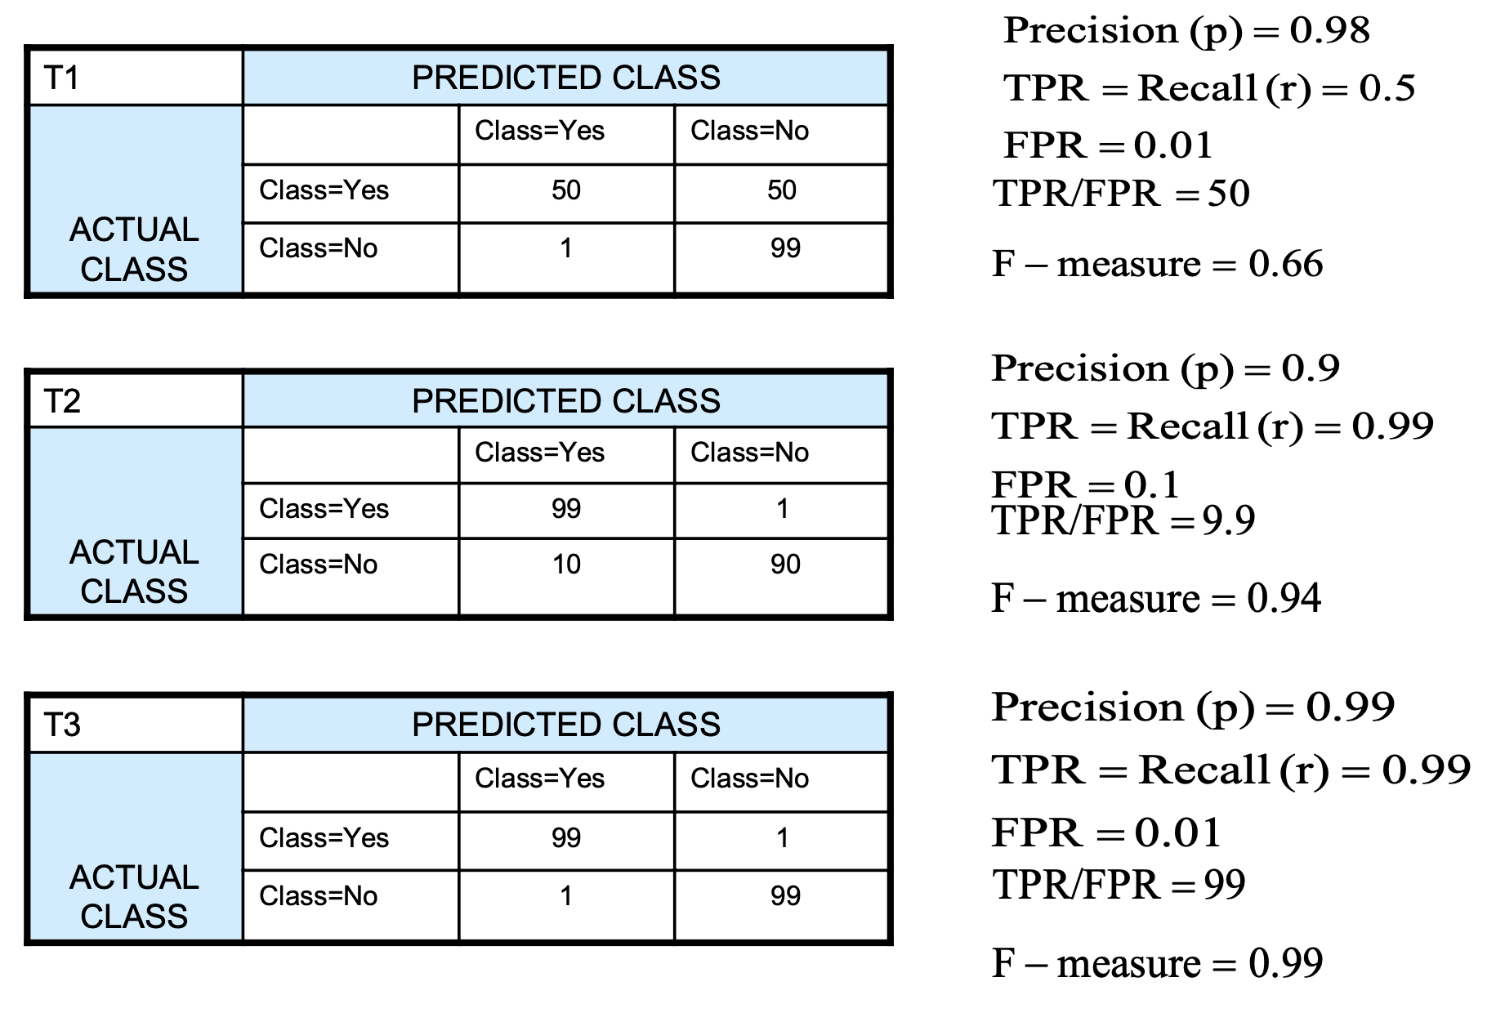
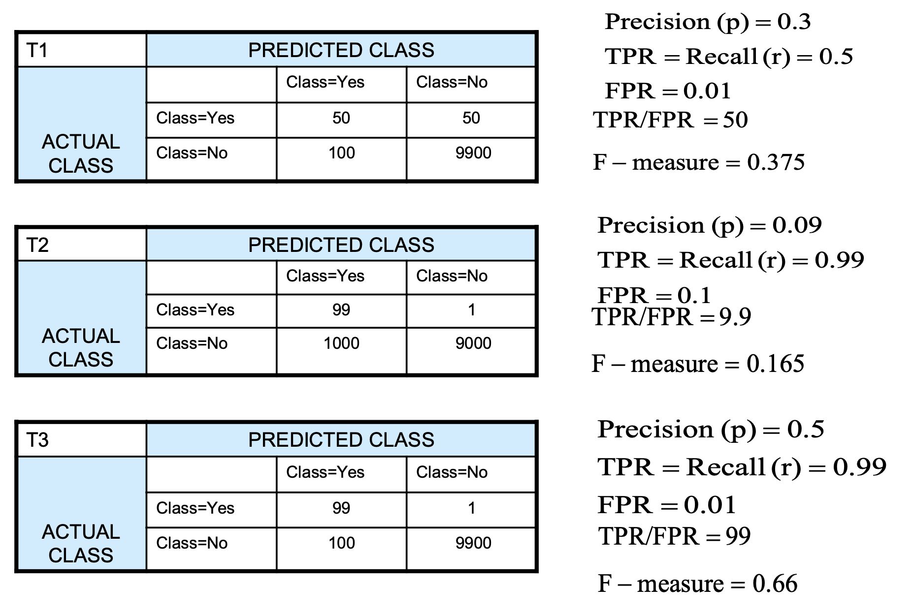
Medium Skew Case
Low Skew Case
High Skew Case

Slide 7
Confusion matrices are an essential tool in evaluating the performance of classification models, especially in machine learning tasks. Here are some key observations you can derive from a confusion matrix:
1. **True Positives (TP)**: These are cases where the model correctly predicts the positive class.
2. **True Negatives (TN)**: These are cases where the model correctly predicts the negative class.
3. **False Positives (FP)**: These are cases where the model incorrectly predicts the positive class when the actual class is negative. Also known as Type I errors.
4. **False Negatives (FN)**: These are cases where the model incorrectly predicts the negative class when the actual class is positive. Also known as Type II errors.
Based on these metrics, you can derive various evaluation metrics for your model, such as:
- **Accuracy**: The proportion of correctly classified instances among the total instances. It's calculated as (TP + TN) / (TP + TN + FP + FN).
- **Precision**: The proportion of true positive predictions among the total positive predictions. It's calculated as TP / (TP + FP).
- **Recall (Sensitivity)**: The proportion of true positive predictions among the actual positive instances. It's calculated as TP / (TP + FN).
- **Specificity**: The proportion of true negative predictions among the actual negative instances. It's calculated as TN / (TN + FP).
- **F1 Score**: The harmonic mean of precision and recall. It provides a balance between precision and recall and is calculated as 2 * (Precision * Recall) / (Precision + Recall).
By analyzing these metrics from the confusion matrix, you can gain insights into the strengths and weaknesses of your classification model. For example:
- High accuracy with low precision indicates a high number of false positives.
- High recall with low specificity indicates a high number of false negatives.
- Balanced precision and recall lead to a high F1 score, indicating a well-performing model.
Overall, the confusion matrix provides a comprehensive view of the model's performance across different classes and helps in fine-tuning the model for better results.

Slide 8
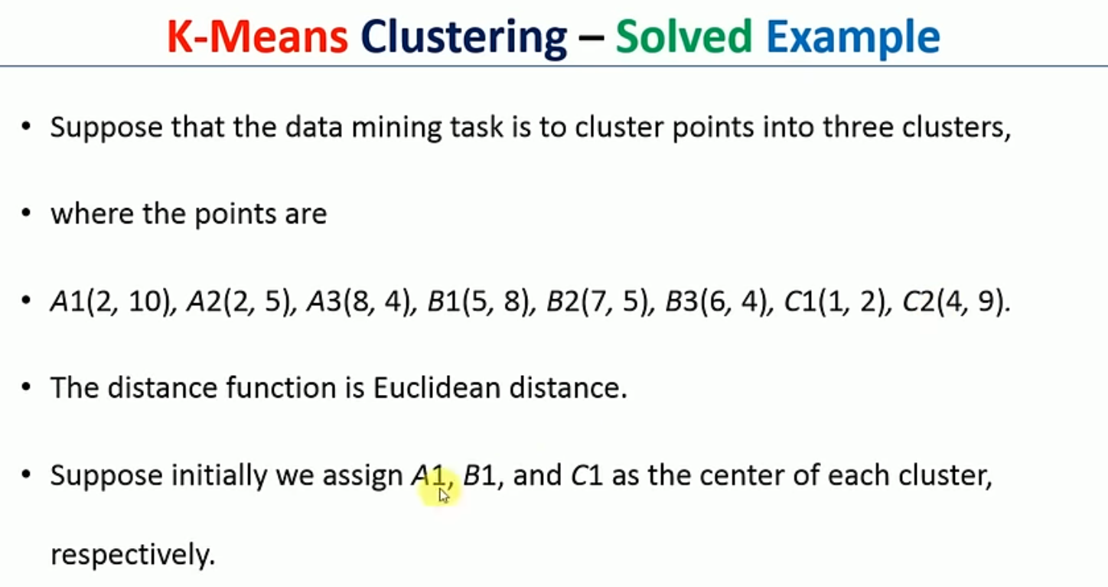
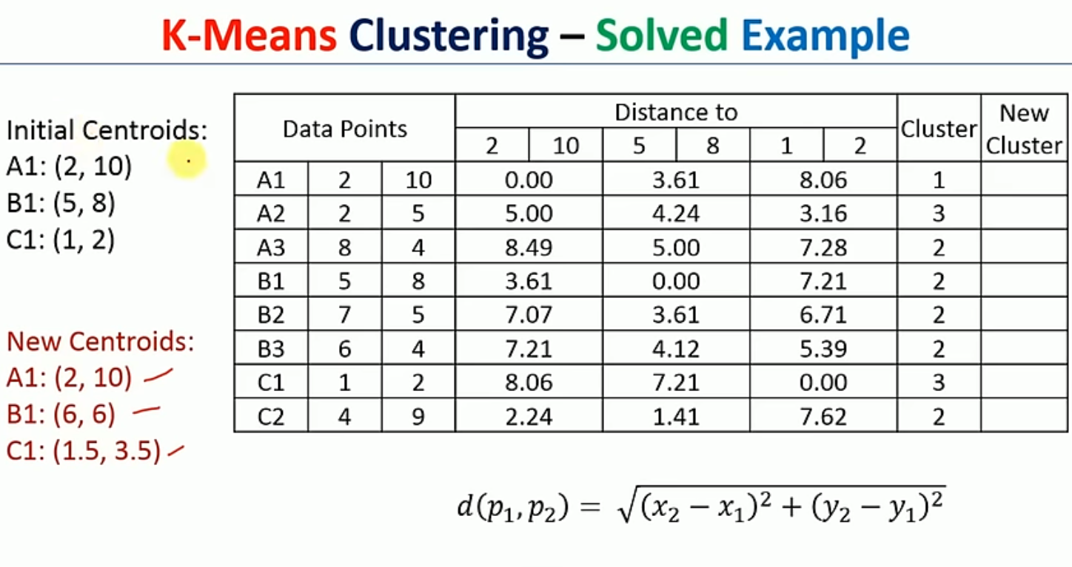
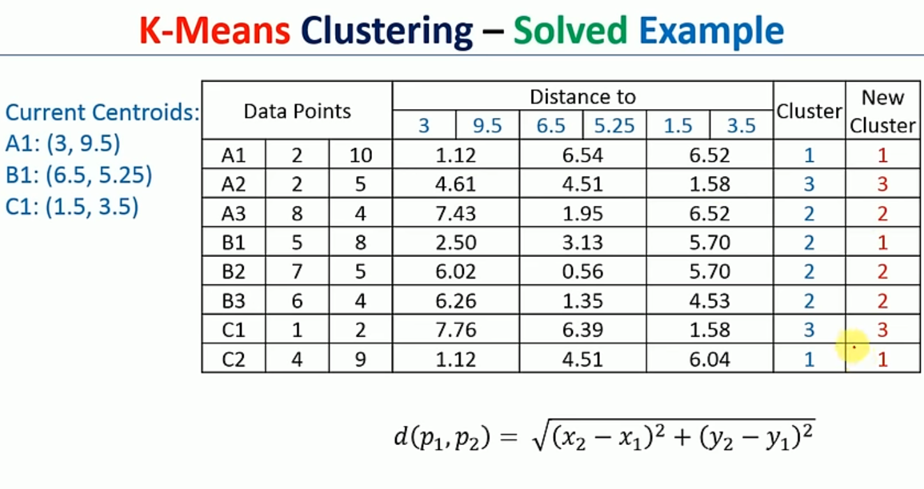
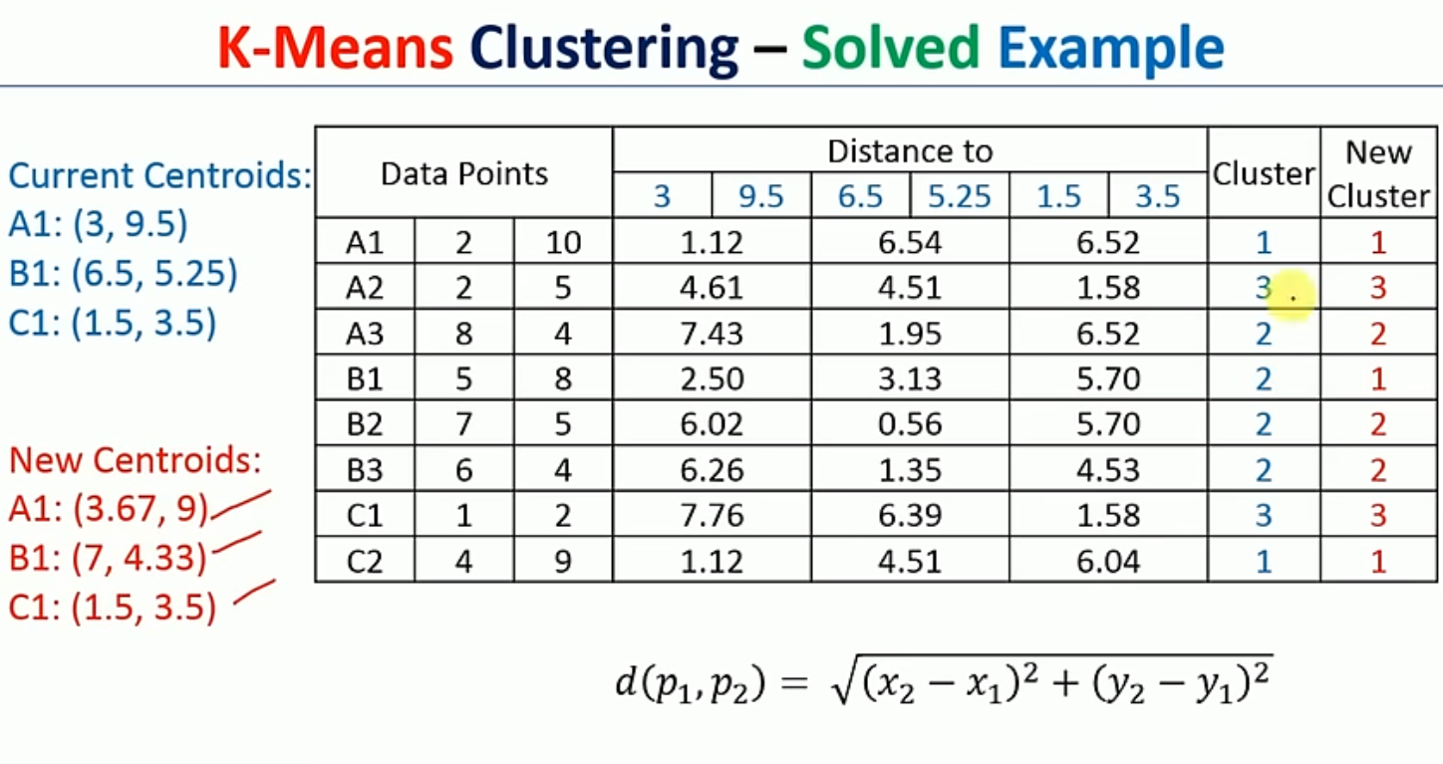
Continue the process getting new centroid until old and new cluster values are same

Slide 9
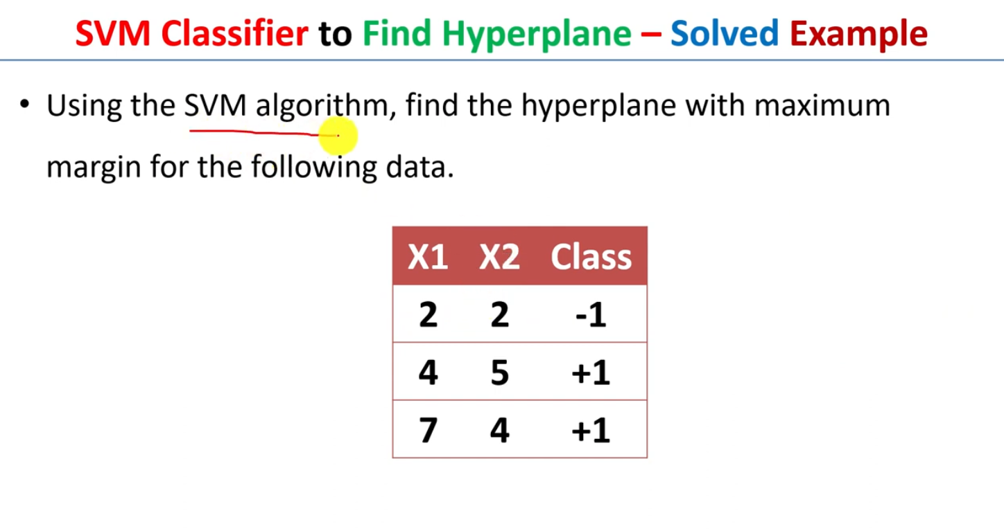
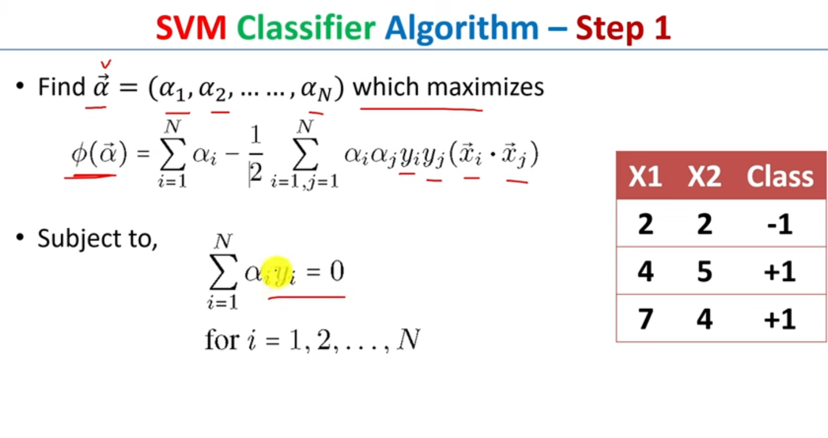
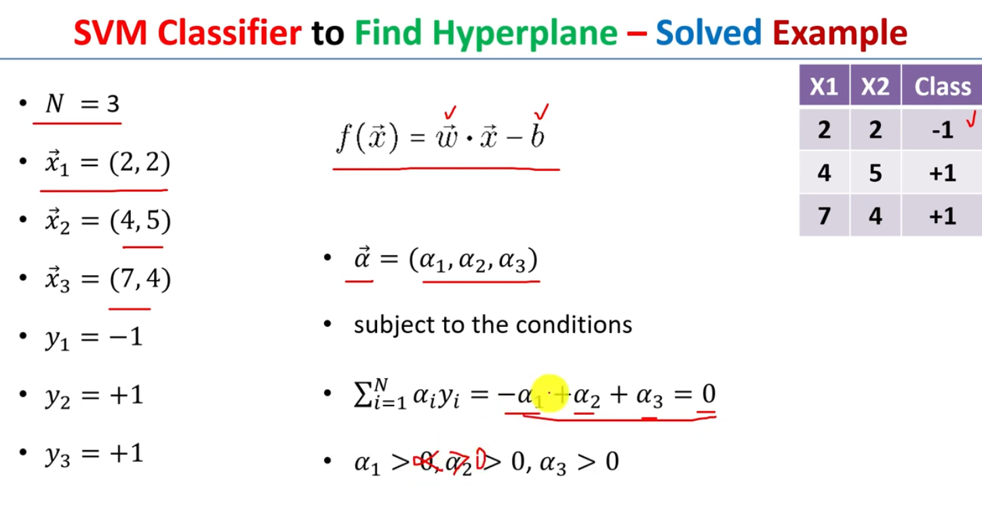
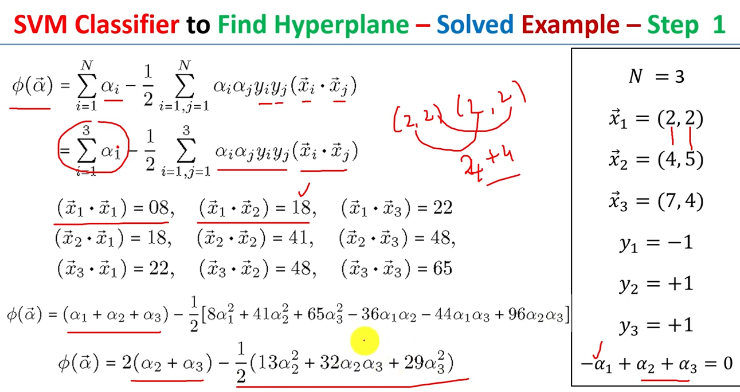

Slide 10
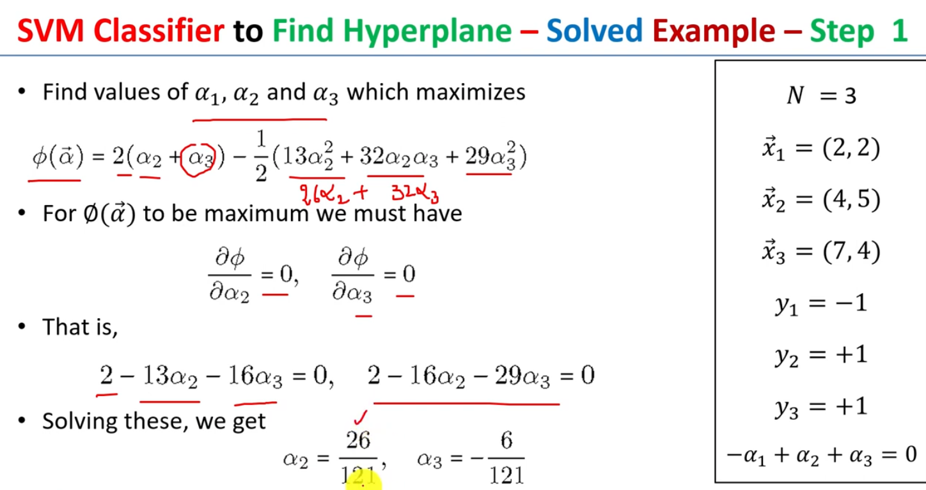
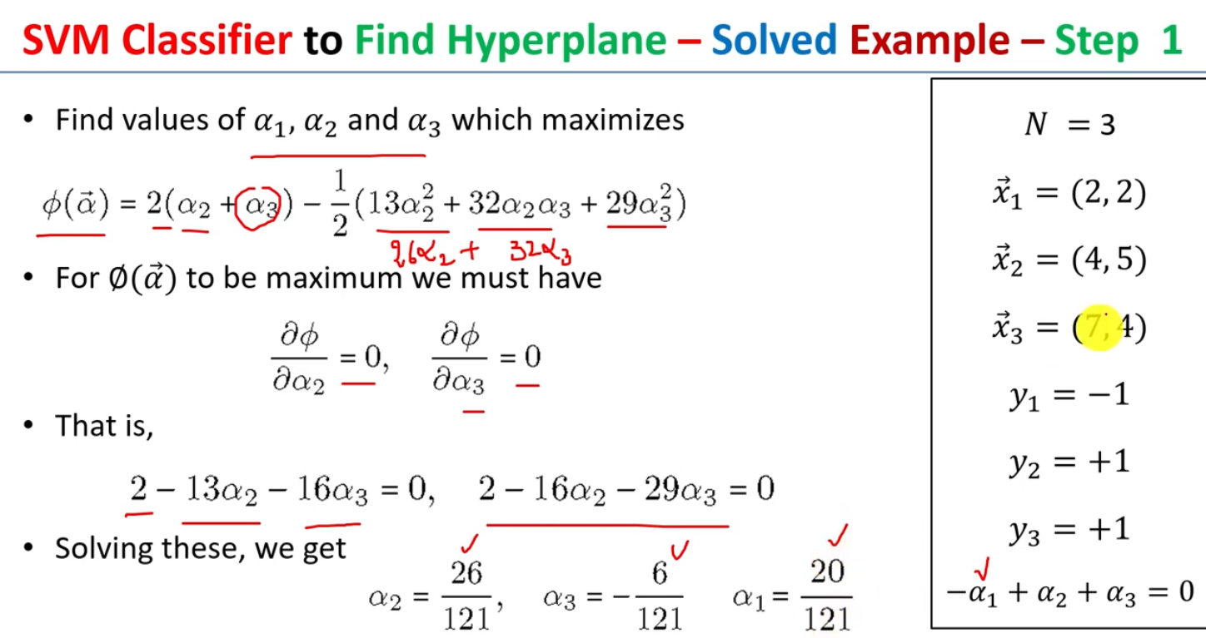
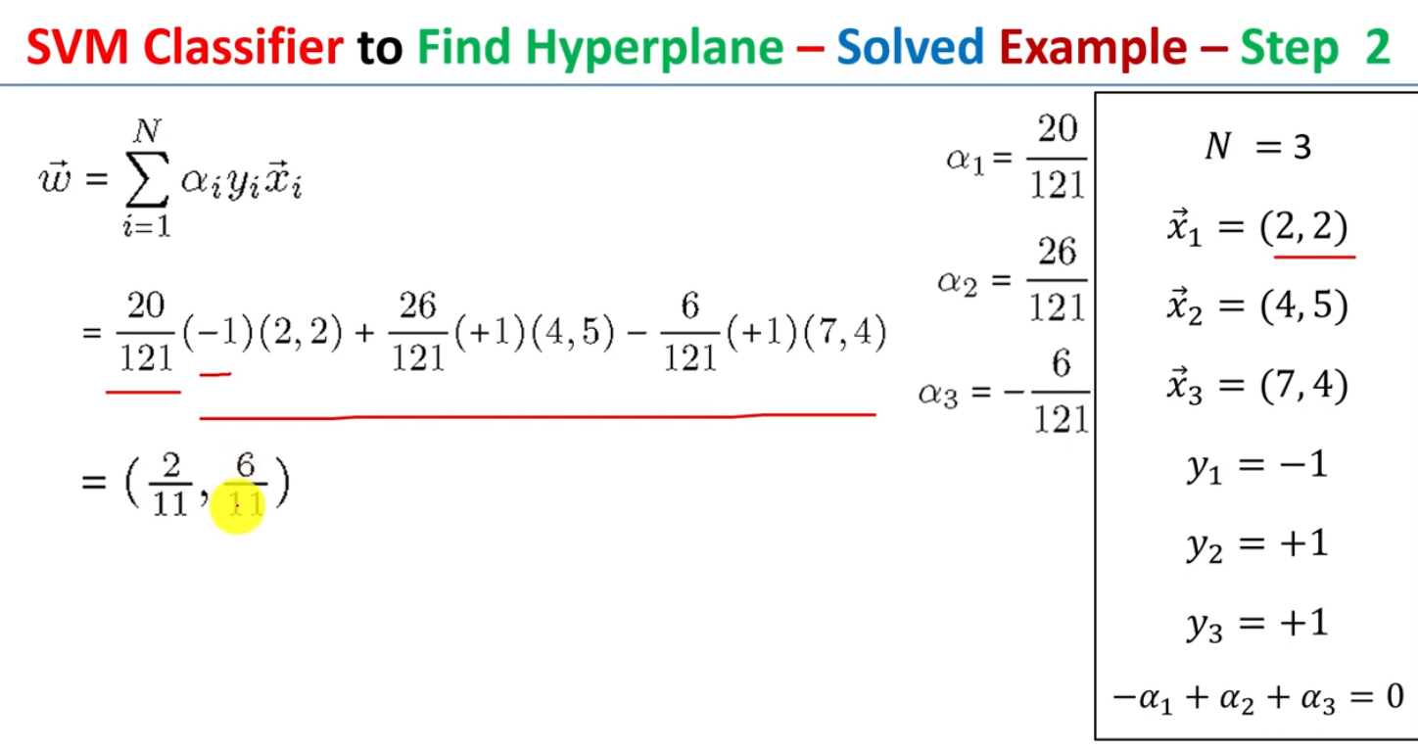
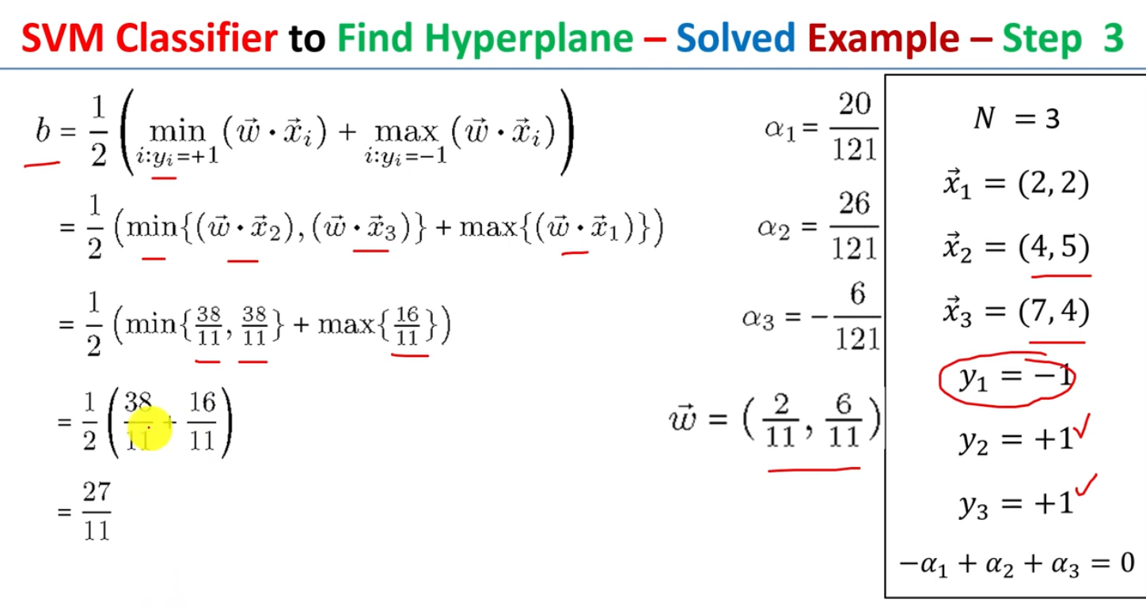

Slide 11
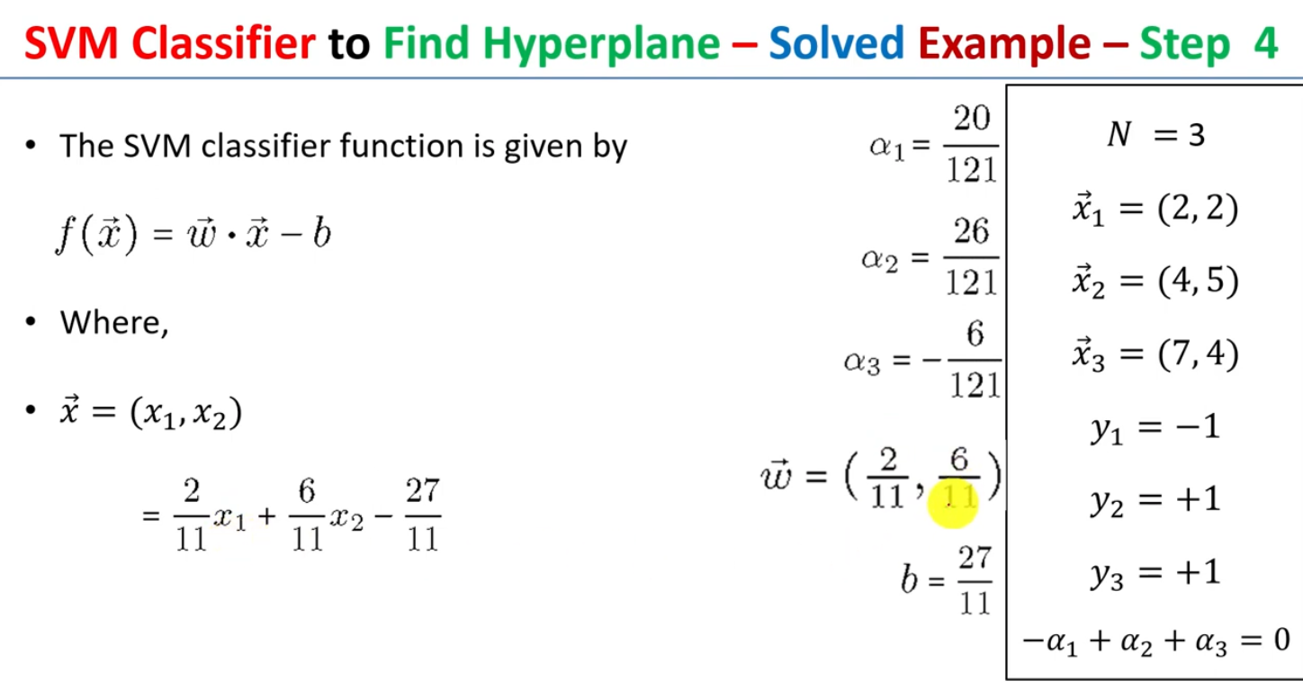
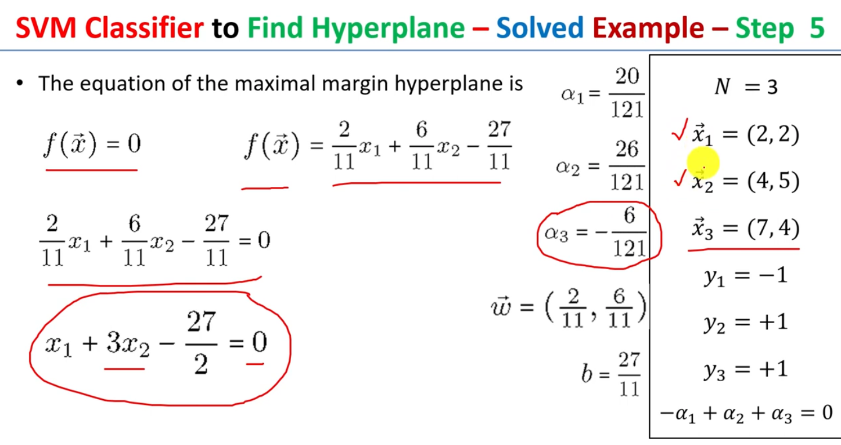
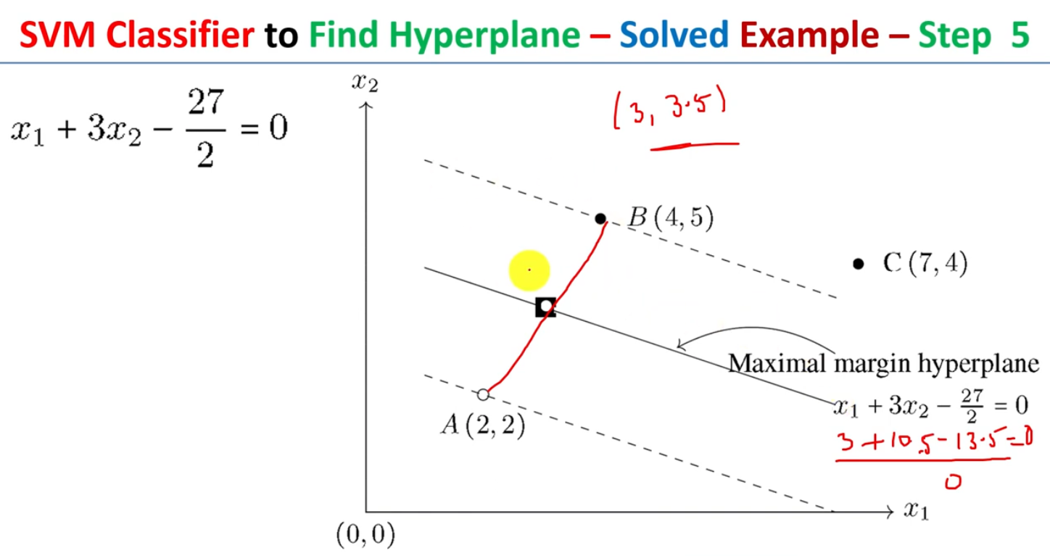

Slide 12
